Slide 1


Popular Culture: The Academic Perspective
Sonal Jha, PhD
Department of Humanities and Social Sciences

Slide 2

Theoretical Frameworks
The Frankfurt School
The Birmingham School
Critical Theory (Adorno & Horkheimer)
Cultural Studies (Stuart Hall)
Views pop culture as "The Culture Industry"—a tool used by the ruling class to maintain a passive, distracted populace.
Views the audience not as passive victims but as active agents.
Pop culture is a "site of struggle" where meaning is constantly negotiated, accepted, or rejected.
Focuses on standardization and the elimination of critical thought.

Slide 3

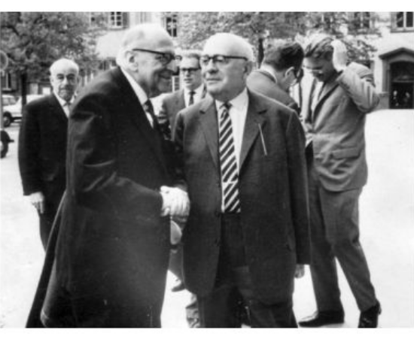
The Frankfurt School: The Culture Industry
Adorno and Horkheimer rejected the term "Popular Culture," preferring "The Culture Industry" to highlight its manufactured nature.
•
Standardization: Media produces standardized goods (films, music) analogous to factory output.
•
Passive Consumption: While "High Art" demands intellectual engagement, pop culture encourages passivity.
•
Social Consequence: A distracted population is less likely to critically engage with political realities.

Slide 4

Example: Barbie (Frankfurt Perspective)
Barbie is not a critique of patriarchy but a sophisticated product of the "Culture Industry" that commodifies feminism to rejuvenate a dying brand.
The audience feels they are participating in a feminist act by buying a ticket, replacing genuine political action with passive entertainment.
Barbie become ‘human’ at the end of the film, to be subsumed in the existing social structure – validation of status quo.

Slide 5
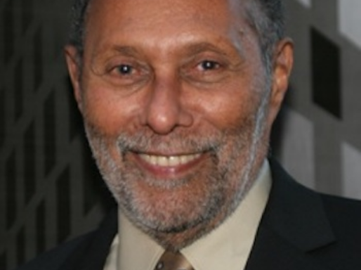
The Birmingham School: Active Audiences
Stuart Hall argued that audiences are not passive "cultural dupes" but active interpreters who bring their own context to media.
Hall’s Encoding/Decoding Model:
•
Dominant Reading: The message is accepted as intended.
•
Negotiated Reading: Parts are accepted, while others are rejected or modified.
•
Oppositional Reading: The message is understood but completely rejected.

Slide 6

Example: Barbie (Birmingham Perspective)
The movie is a space where audiences actively negotiate meaning rather than just absorbing it.
Varied Readings:
Dominant: Agree with the feminist message.
Negotiated: See it as a corporate toy commercial but appreciate the mother-daughter narrative.
Oppositional: Dismiss it as 'plastic feminism' or 'anti-man propaganda'.
The meaning of Barbie is found in the active relationship between the text and the audience.

Slide 7
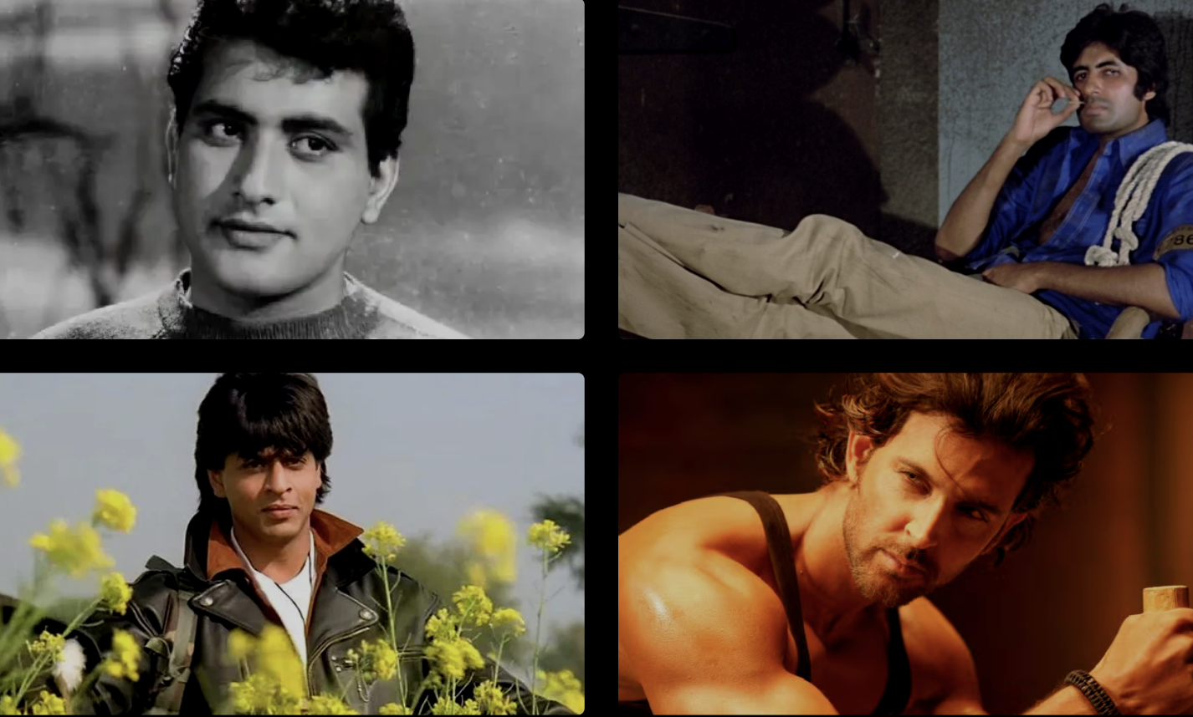
Why Study Pop Culture? (I)
Rejecting Elitism
The academic turn toward pop culture (c. 1970s) rejected the idea that culture is only the "best that has been thought and said" (High Culture as per Arnold). Instead, it views culture as a whole way of life.
Alternate Archive
While official history records wars and laws, pop culture records the texture of everyday life – slang, fashion, music – provides a view of society not captured in history books. For example, the evolution of the Bollywood hero reflects the changing socio-political conditions of the Indian nation.

Slide 8


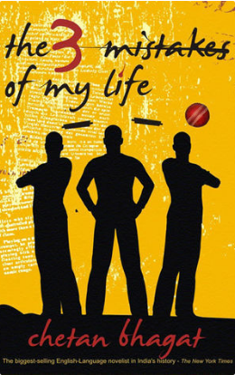
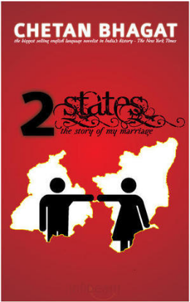
Why Study Pop Culture? (II)
We study popular culture not because it is ‘good’ in an aesthetic sense but because it is socially consequential. It is an arena where social values are reflected and contested
For example, the works of Chetan Bhagat, document the aspirations of the middle class, the rise of call center culture, and the anxieties of modern Indian youth.

Slide 9









Conclusion: Lived Experience & Power
Societal Mirror
Social Change
Social Control
It reflects the life, norms, and values of a specific historical moment.
Representation in media can "normalize" behaviors and shift public opinion.
It can also serve to reinforce stereotypes and hegemonic structures.

